Slide 1
Sanitary Engineering
Sewerage Engineering
D.O. & D0 Examples
By
Dr. Muhanad M. Abbas

Slide 4
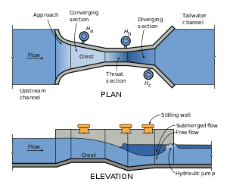
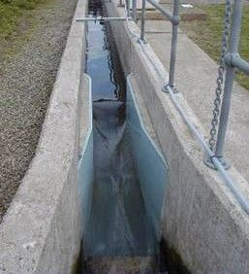

Slide 5
